Slide 1


AMAZON AND EBAY

Slide 2

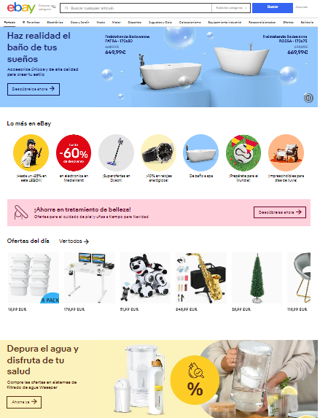

Slide 3
Golden Rules | Amazon | Ebay
1. Strive for Consistency | 8 | 8
2. Seek Universal Usability | 6 | 7
3. Offer Informative Fedback | 7 | 8
4. Design Dialogues to Yield Closure | 7 | 6
5. Prevent Errors | 9 | 7
6. Permit Easy Reversal | 9 | 8
7. Keep Users in Control | 6 | 6
8. Reduce Short-Term Memory Load | 7 | 8

Slide 4
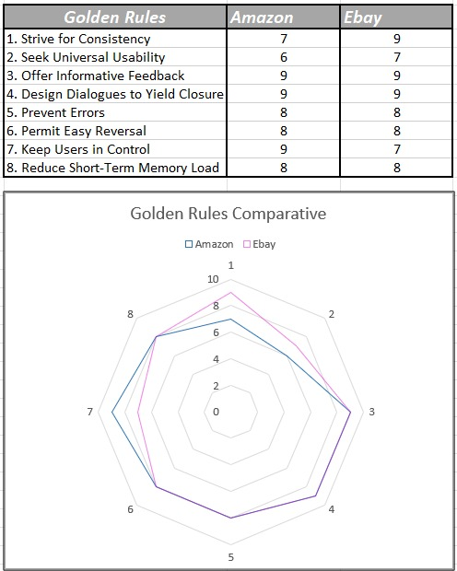

Slide 5
